Slide 1
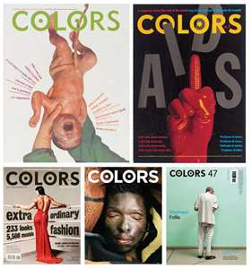
Product and corporate advertising

Slide 2
VOCABULARY
Shocking advertising /ʃɒkiŋ 'æd.vǝ.taɪ.zɪŋ/- is a type of advertising generally regarded as one that deliberately, rather than inadvertently , offends its audiences by violating its norms for social values and personal ideals. Is designed principally to break through advertising clutter to capture attention and create buzz, and also to attract an audience to a certain brand or bring awereness of racism, and other injustice etc

Slide 3
VOCABULARY
Sacrilege /‘sæk.rɪ.lɪdʒ/- treating a sacred thing or place with disrispect; ( svetogrđe); she regarded the damage done to the painting as sacrilege
Scrapping off /'skræpiŋ of/ - to clear or remove; ( struganje); Workmen have been busy scrapping of the bilboard.
Adland thinkers /ædlænd θɪŋ.kǝ:z/ - people who create advertising campaign; (kreatori reklama); The adland thinkers decided the ads should deal more with social issues.
Inception /in’sep.ǝʃ^{ǝ}n/ - an act, processor instance of beginning; He had been director of a project since its inception
Media coverage /’miː.di.ǝ kʌv.^{ǝ}rɪdʒ/ - report about something in the media; this was a good media coverage.
Receptive /rɪ’sep.tɪv/ - capable of, or qualified for receiving, ready or willing to receive; ( onaj koji prima); The company was receptive to new developements.
Open minded /’əʊ.p^{ǝ}n maɪndid/ - receptive to new and different ideas or the opinions of the others; ( onaj tko ima otvorene nazore); He wished his parents were more open minded about the polytical issues.
Broad minded /brɔːd maɪndid/ - free from prejudice or bigotry, liberal, tolerant; (slobodan od predrasuda); New generations are more broad minded than the previous.

Slide 4
Sacrilege
The German carmakers VW`s was likened to a religious revelation; one that showed Jesus at the last supper recomanding the car his disciples. The Adman figuered that outrageous advertising build Benetton into a one of the worlds most recognized brand, it could work to revive the image of the Golf and make it closer to young generations. After that Chatholic Church threatened to sue to obtain the reputation for the damage suffered by Christians. The agency confessed the sins and agreed to remove the ads and to make a substantial donation to the Chatholic charity. Since the consumers have been exposed to too many commercial messages, the Adland thinkers concluded that shocking advertising attracts more consumer`s attention.Todays ad agencies are selling their ability to write ads to generate PR and to garner extra publicity. Advertising agencies cannot expact the consumers to take sales at face value, because they prefer brands that will give them something back. Supporters of Benettons work believe that agency`s success lies in knowing its target and that in marketing terms the only real taboo is upsetting people you want to buy your product. Since the new generations are more broad minded from their parents , the outrageous advertising won`t be limited to the products that target youth. Perhaps the VW`s was ahead of its time advertising to a market that was not broad minded enough.

Slide 5
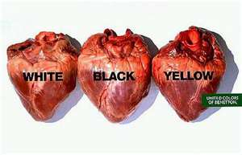
Advertising campaign

Slide 6
Marketing best practises
Advertising campaign is a specific cours of action, cause or a product that employs an international and carefully coordinated series of marketing tools in order to reach the target audience. The end purpose of any campaign is to boost awareness of the subject matter and generate demand. The exact structure of the advertising campaign will often depend on the nature of the product or cause and target audience that campaign is designed to reach. In the time past, electronic media reffered more to TV and radio broadcasts, that component now include tools such as online banner ads, text messaging and e-mail advertisments

Slide 7
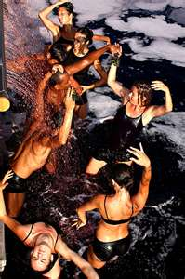
4 types of advertising campaigns
A word hook
A character hook
A repeatable theme
A consistent brand layout

Slide 8
How do they function?
Since people are bombarded by too much informations every day most of them will not be registered. They will scan them in a blink and process them. Those 4 types of advertising campaigns first function as handless, or entering points, that allow information to be processed quickly. Because information can be transmitted, a sales proposition can be made. The second reason why these campaigns are essential is that they create a powerful mental images, which is the link between branding and sales. Consider how your mind works. Mental images flip by in little movies at blinding speed.

Slide 9
A word hook and a character hook
A word hook is repeatable catch phrase from ad to ad; example Master card;" Priceless“ campaign. Master Card has added new U. S. Credit cards at more than twice Visa`s rate. The word hook is like a chorus of a pop song. They are catchy. The triumph of a great marketing catch phrase is when it becomes so well known, it additionally can serve as a cultural joke.
A character hook uses a hero, a villain or victim to emboy a key attribute of a brand. Characters are tremendeous for breaking through advertising clutter and establishing emotional connections with customers. They are vivid, intriguing and cause us to care about them. If you care about the character you will care about the brand.Buying life insurance is something people would rather not think about. By using Snoopy, people like Metlife, make the company more approachable.Today Metlife is the larger U. S. Insurance company.

Slide 10
The repeatable theme and consistent layout
The repeatable theme is a situation that plays out again and again calling out the need for a company`s product. “Think fun“ is the concept idea of this type of advertising
Consistent layout uses unique design look and repeats these elements at each touchpoint. It allows customers to easily identify your company in a blink. The more distinct these elements are from your competitors, the easier it is to stand out from the clutter. The key of the consistent layout is that is everyone else is corporate blue you want to be another colour. Consistent design is about consciously standing out from the crowd and keeping your trademark design going on everything. The sales moment is the single mental image that satisfies the customers unmet need.

Slide 11

Match the phrases from the box A with the phrases in the box B
A
1. Consumer prefer brands
2. Ad agencies are selling
3. A deliberately shocking ad is
4. success lies in
5. In marketing terms
6. Young people are
B
a) the only real taboo is upsetting people you want to buy your product
b) the ability to write ads that generate PR
c) that give them something back
d) receptive to taboo breaking
e) knowing its target
f) is the simplest way to get additional media coverage

Slide 12
Mark the following statements as true or false
Young people are receptive to taboo breaking. T or F
Young people dislike advertising that annoys their parents. T or F
Brands can expect their consumers to take sales messages at face value. T or F
The negative media coverage does not help to sell the product. T or F
Succes of the company lies in knowing its target. T or F

